Slide 1
CHAPTER 8
Principles of inheritance- Gene interactions

Slide 2
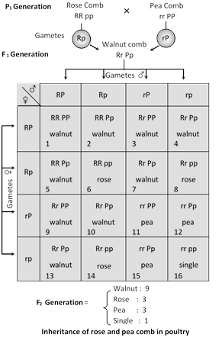
Collaborator genes
In collaboration two gene pairs, which are present on separate loci but influence the same trait, interact to produce some totally new trait or phenotype that neither of the genes by itself could produce.
Example : Inheritance of combs in poultry, where two genes control the development of comb.

Slide 14
How to detect the skin colour genetically?
6 dominant – black - 1
5 dominant- very dark - 6
4 dominant – dark - 15
3 dominant – intermediate - 20
2 dominant- fair - 15
1 dominant – very fair -6
0 dominant - albino - 1

Slide 15
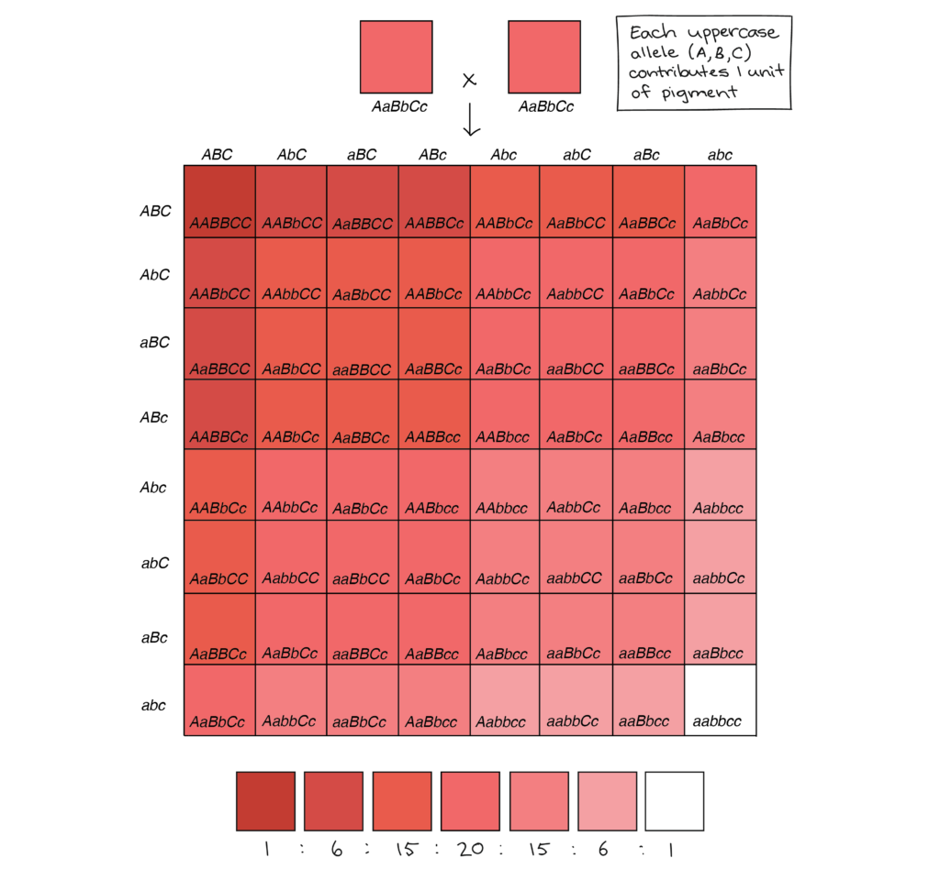

Slide 16
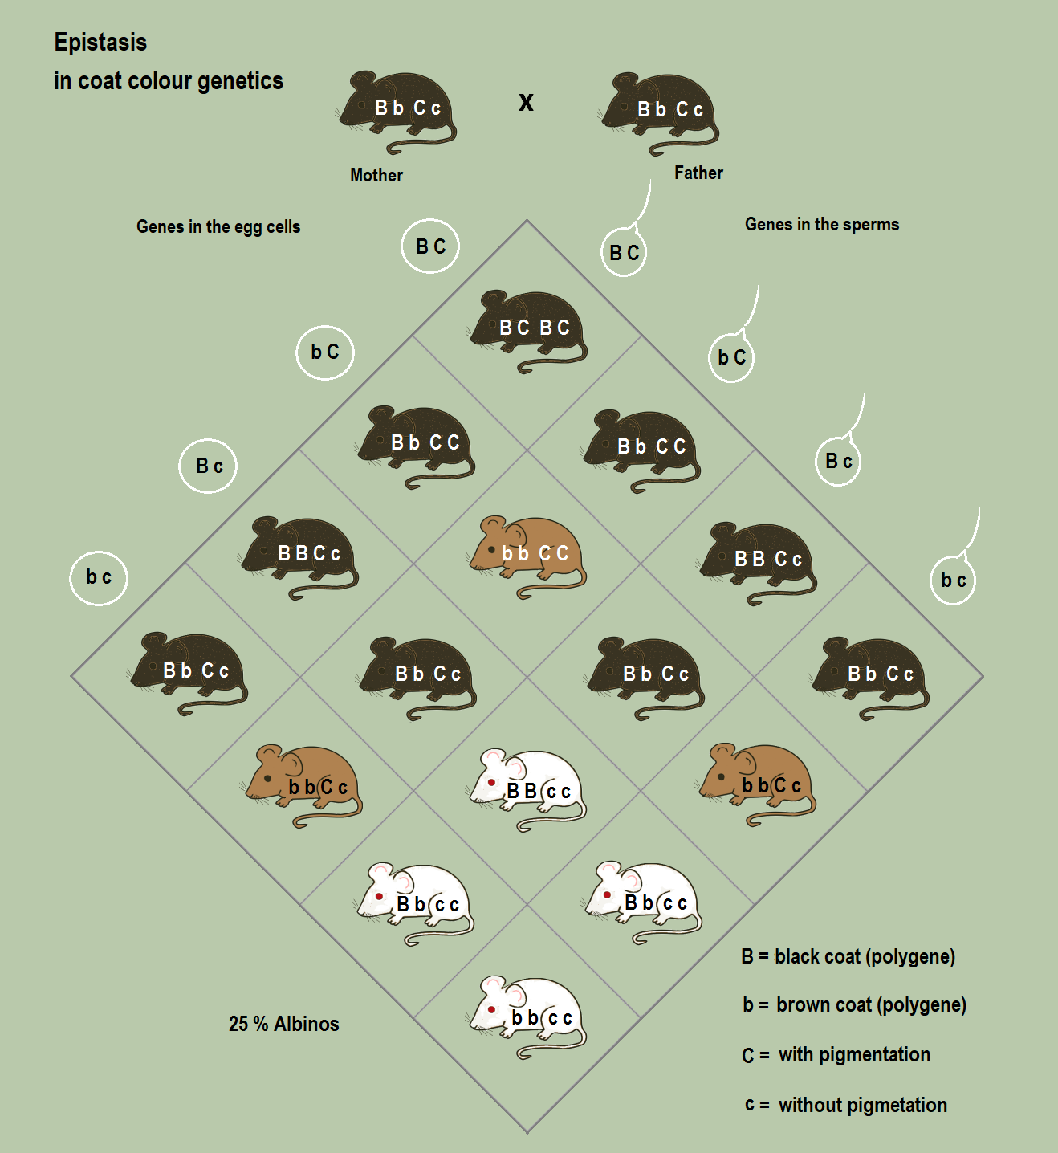

Slide 17
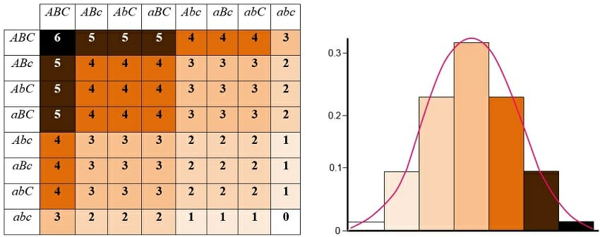
Polygenic interaction

